Slide 1
AFRICA’S FISCAL TIME BOMB
Predictive Analytics for Sustainable Public Finance
By: ADESIDA OLUWASEUN IYANU 10Alytics Hackathon 2025 • 29th/November/2025
Supporting SDG 8 — Economic Growth & SDG 16 — Strong Institutions

Slide 2
PROBLEM STATEMENT & OBJECTIVES
THE PROBLEM
Persistent fiscal deficits
Rising debt burdens
Extreme revenue volatility
High exposure to global shocks
WHY THIS MATTERS
Threatens macroeconomic stability
Crowds out development spending
Slows progress toward SDG 8 & SDG 16
Increases the likelihood of sovereign crises
OBJECTIVES OF THIS STUDY
Understand long-term fiscal patterns
Identify key drivers of fiscal risk
Detect anomalies & emerging crises
Forecast fiscal sustainability
Recommend actionable, data-driven policies

Slide 3
DATA & METHODOLOGY
DATASET
Source: 10Alytics Fiscal Dataset
Coverage: 14 African countries
Time frame: Years 1960–2025
Key variables: Revenue, Expenditure, Debt, GDP, Fiscal Balance, Indicators

Slide 4
METHODS USED
1. Data Preparation
Cleaning and standardization
Converting long format → analyzable structures
Creating ratios:
Debt/GDP
Fiscal Balance/GDP
Revenue volatility
2. Descriptive Analytics
Trend analysis
Cross-country comparison

Slide 5
3. Risk Assessment
Composite Fiscal Risk Score
High/Moderate/Low classification
4. Anomaly Detection
Z-Score detection
Isolation Forest (ML-based)
5. Forecasting
Multi-year trend modeling
2025–2029 projections

Slide 6
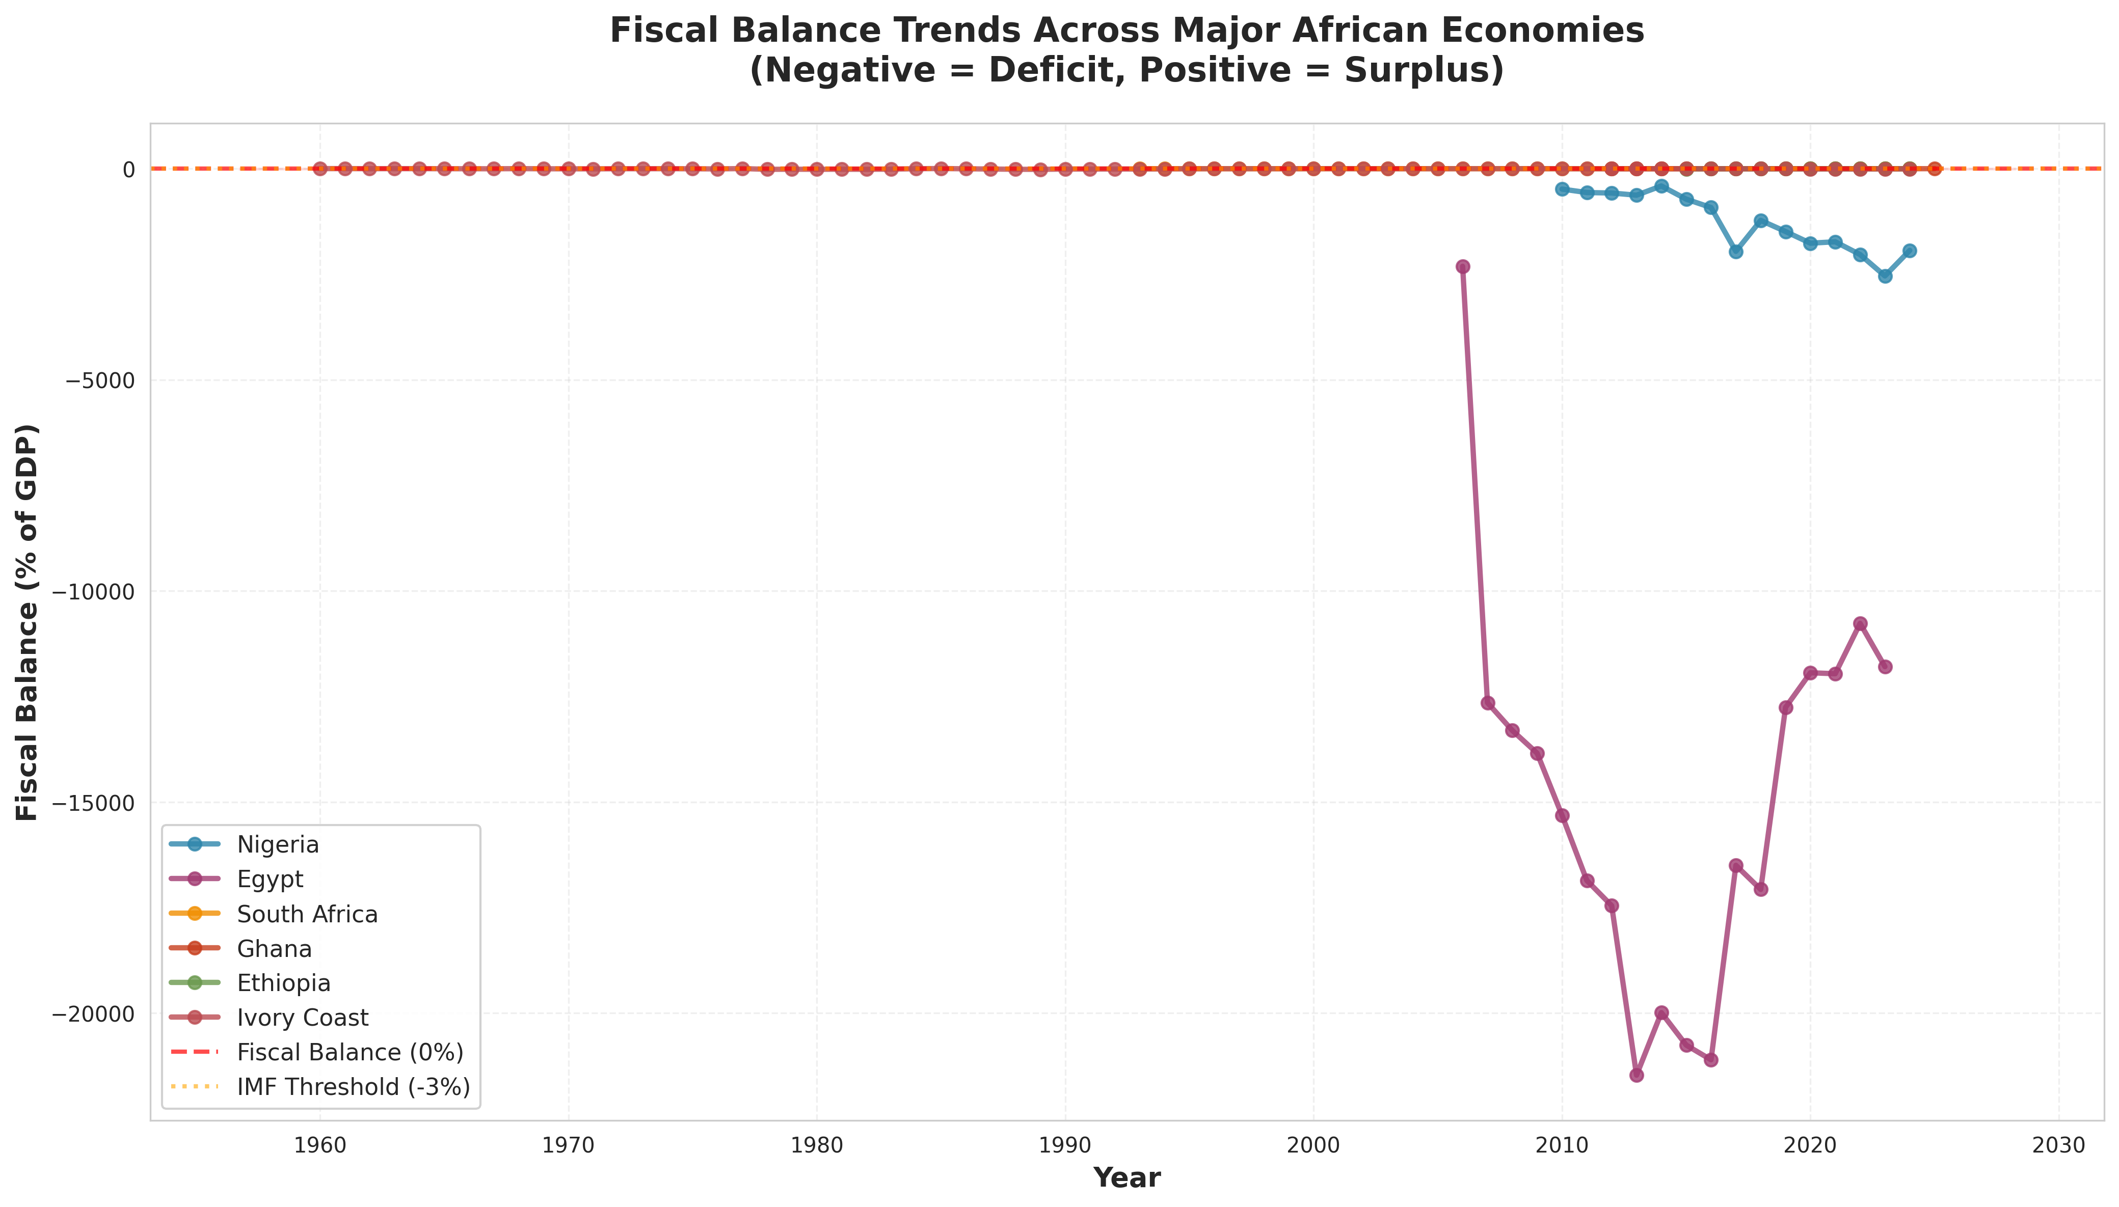
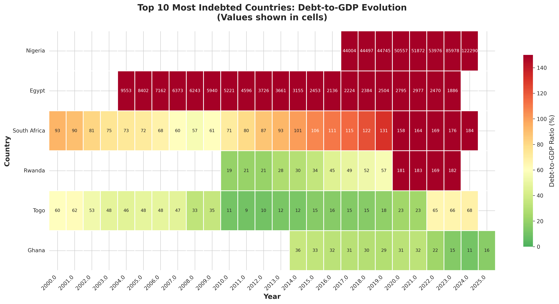
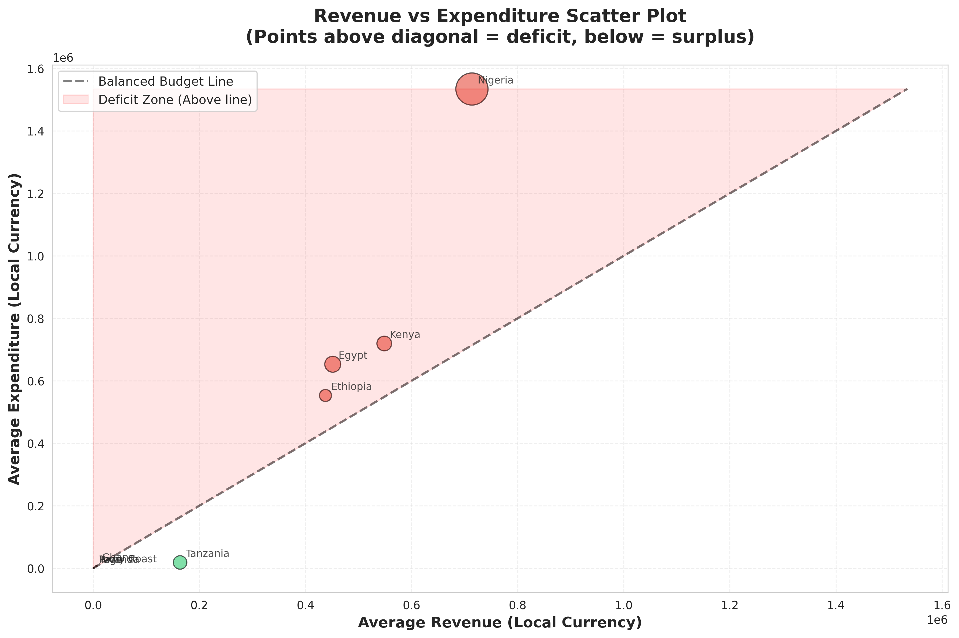
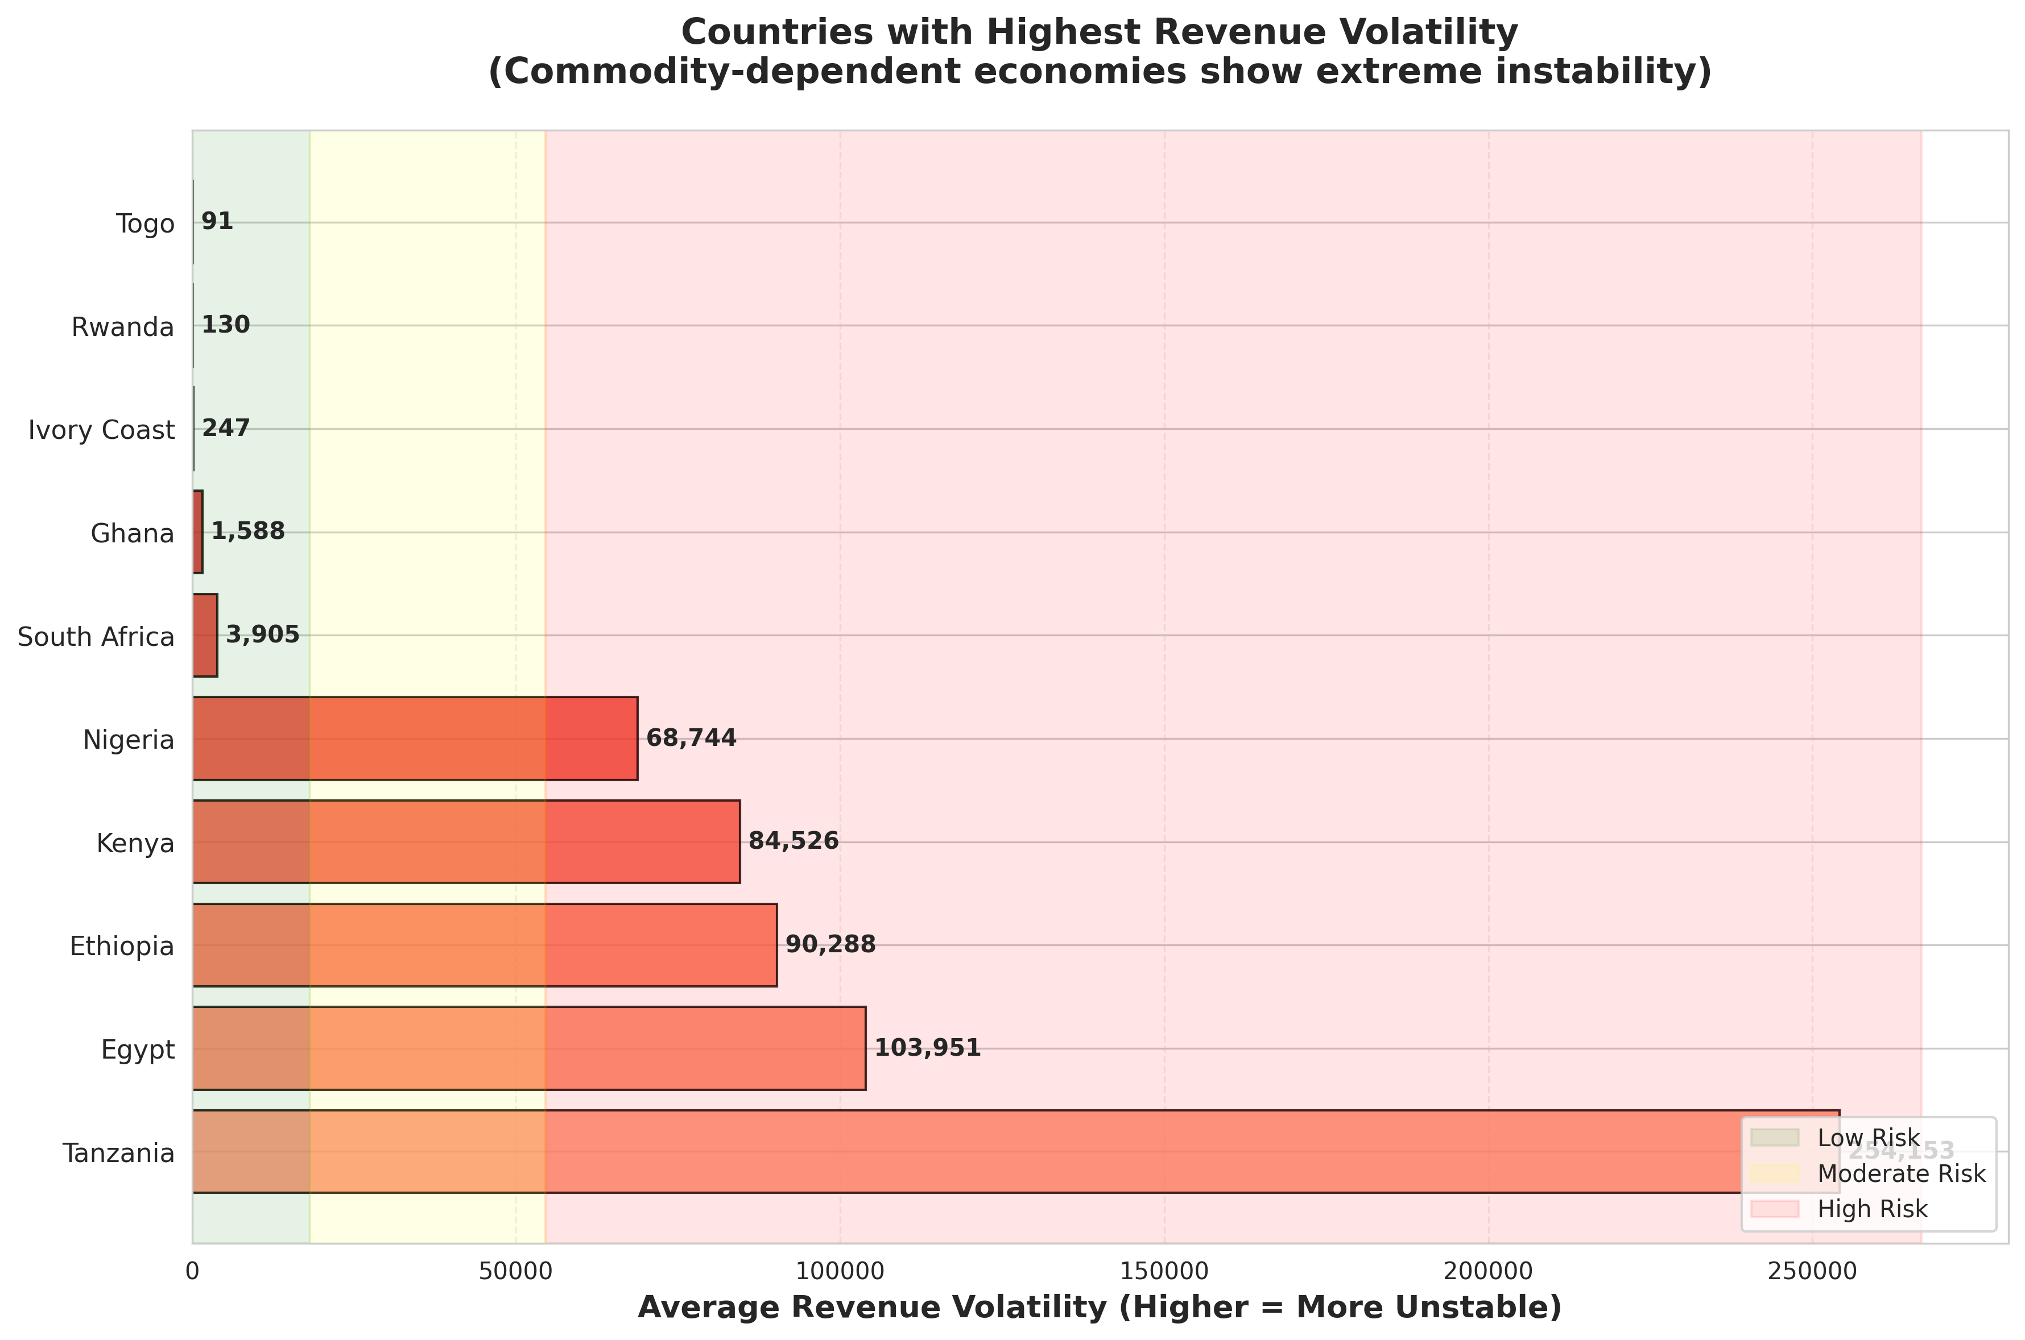
KEY FINDINGS: FISCAL TRENDS
Multi-panel trend chart
(Deficit trends, Debt/GDP, Revenue volatility, Expenditure trends)

Slide 7
INSIGHTS — Using my real numbers
Average fiscal deficit: –1342.64% of GDP
Countries in persistent deficit (>3 years): 6 (43%)
Average debt/GDP: 4194.7%
Countries exceeding 60% debt threshold: 5
Average revenue volatility: 33,220.6%
BOTTOM LINE:
These are structural fiscal imbalances, not temporary disruptions.

Slide 8
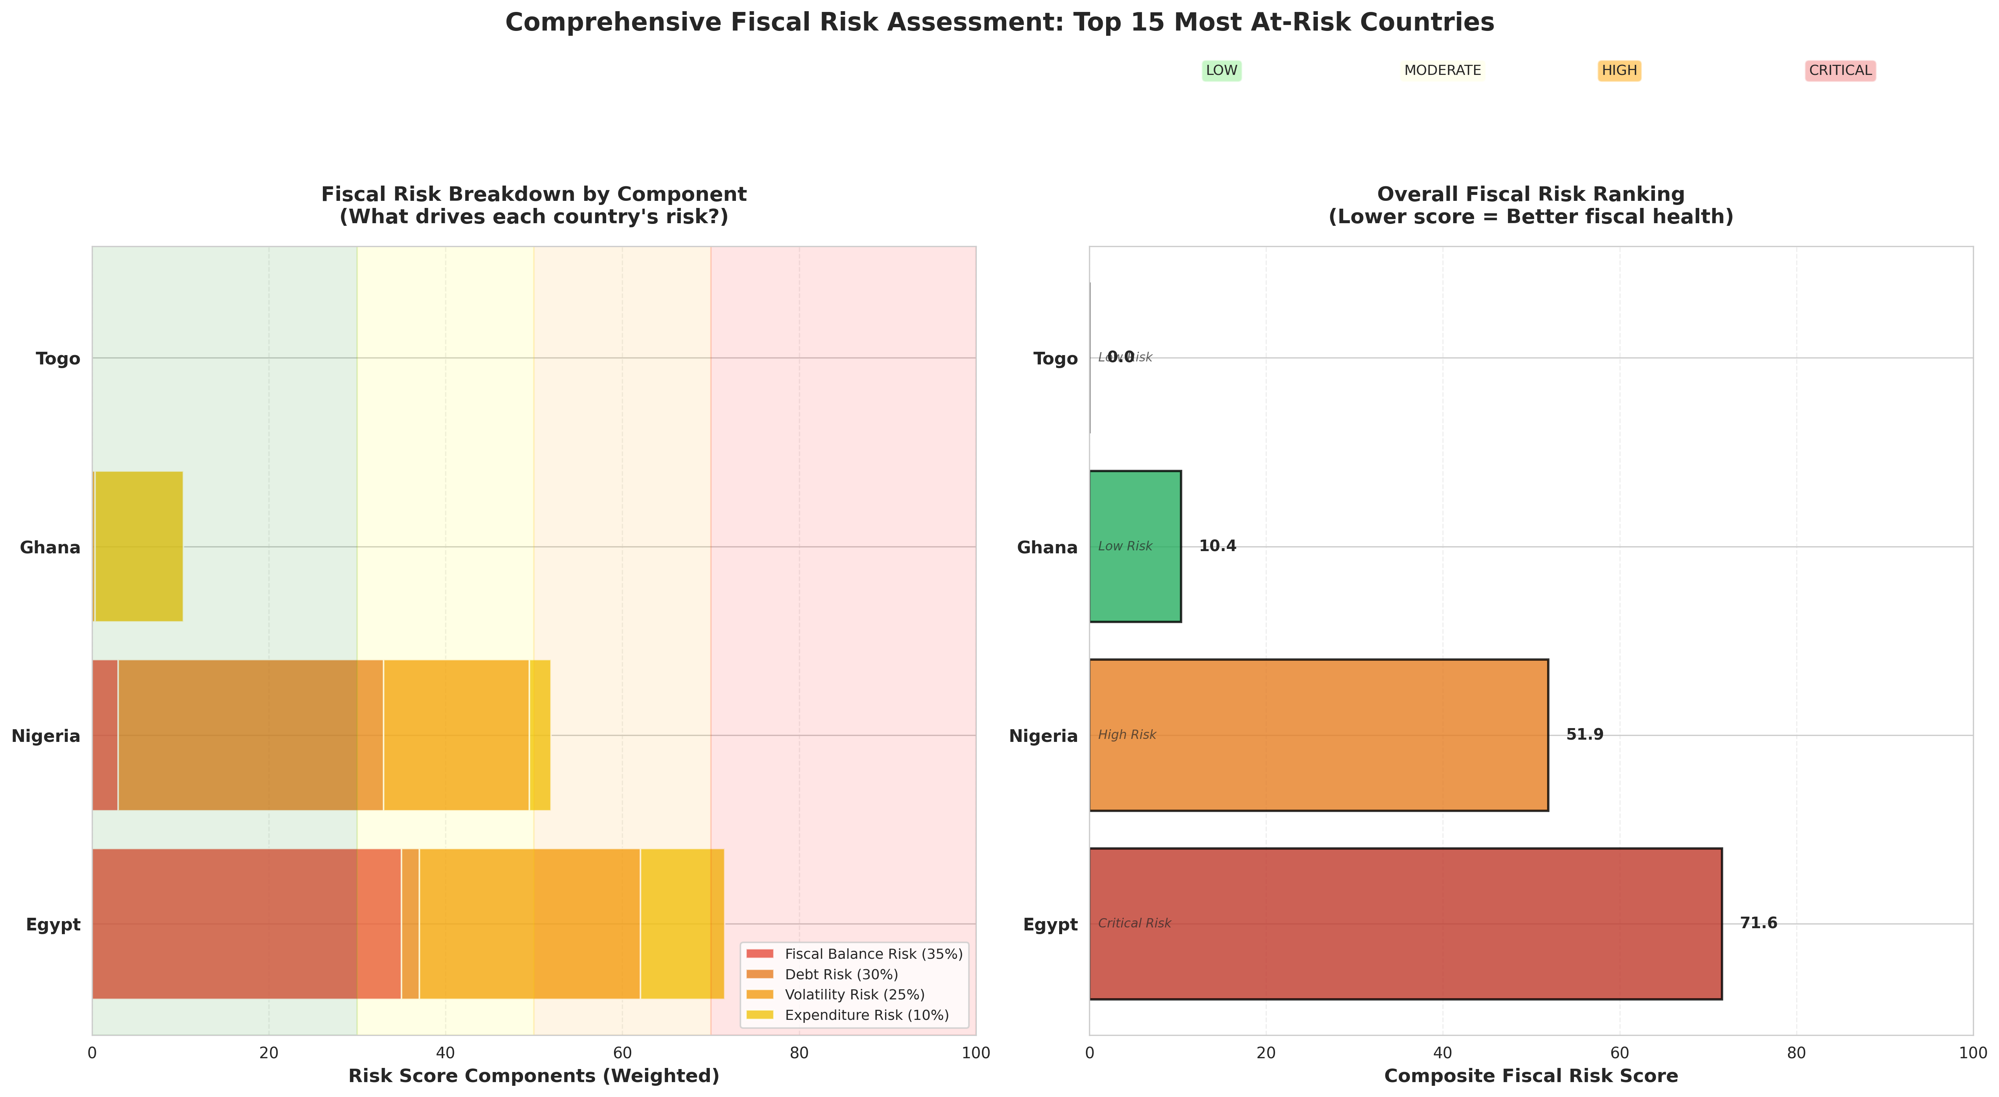
KEY FINDINGS: RISK ANALYSIS

Slide 9
RISK CLASSIFICATION — Using my numbers
High Risk: 1 country
Moderate Risk: 1 country
Low Risk: 2 countries
TOP RISK DRIVERS
Revenue volatility
Debt accumulation
Persistent deficits
TOP 4 HIGH-RISK COUNTRIES
Togo — Score: 0.0
Ghana — Score: 10.4
Nigeria — Score: 51.9
Egypt — Score: 71.6
CRITICAL INSIGHT:
Revenue instability explains most of the variation in fiscal risk.

Slide 10
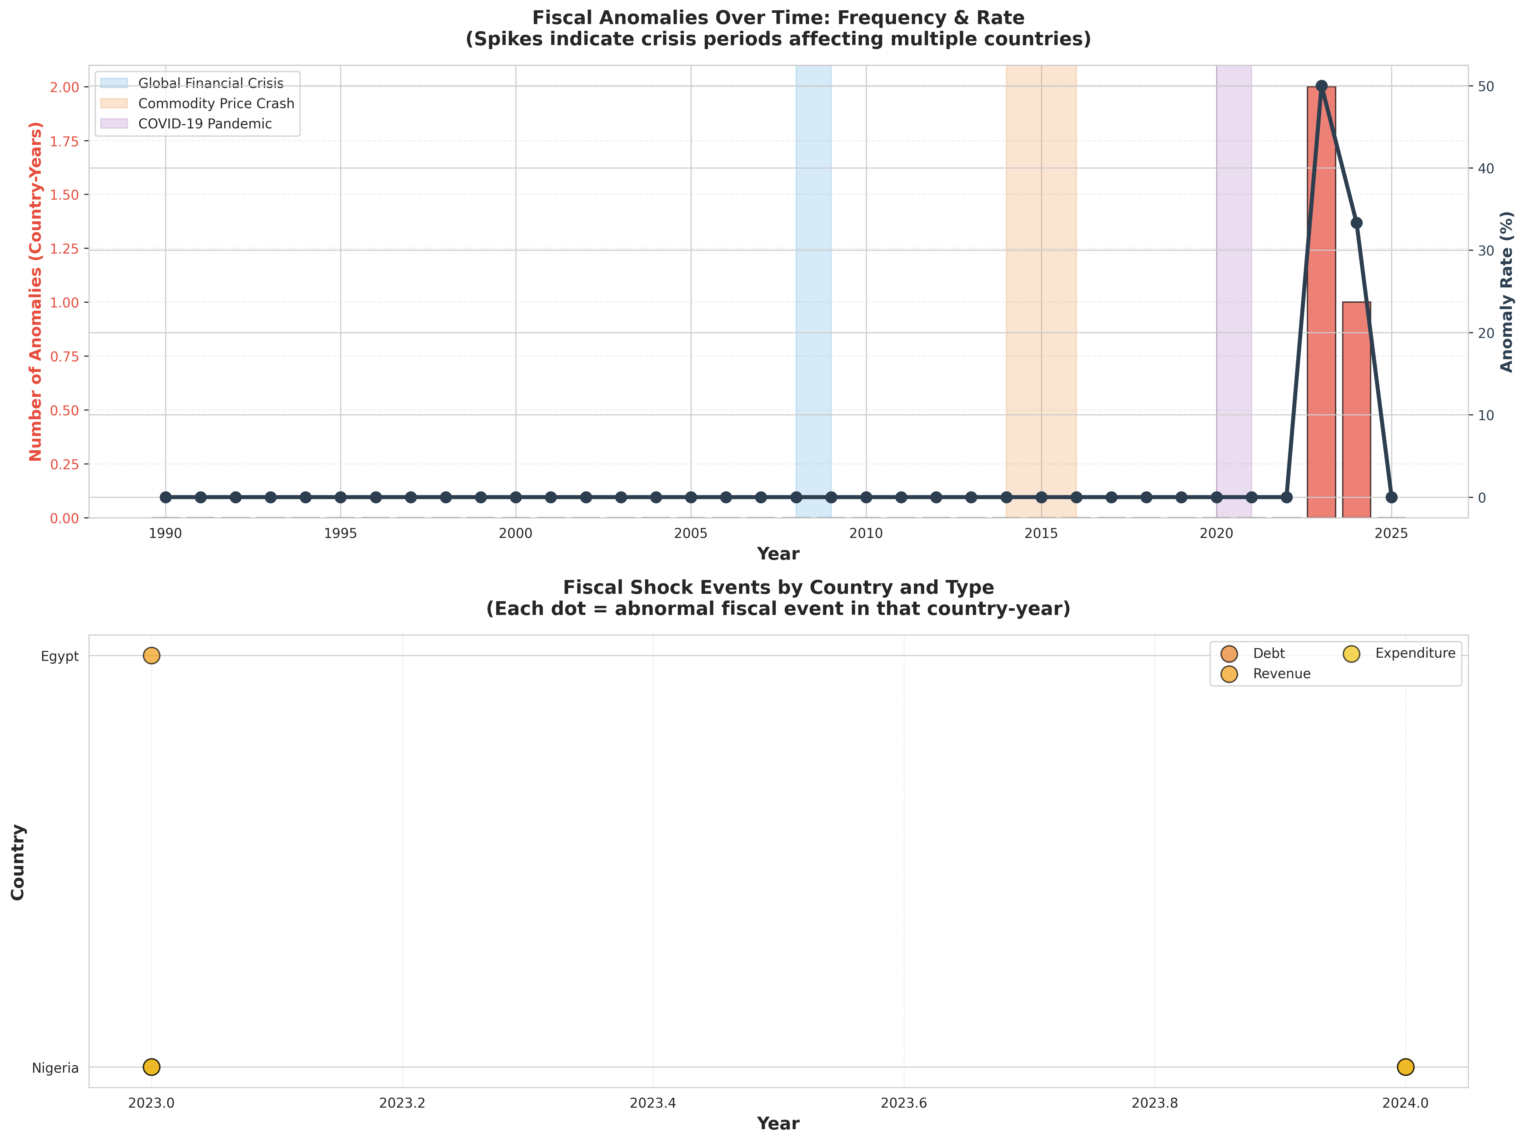
KEY FINDINGS: ANOMALY DETECTION
Anomaly timeline chart

Slide 11
SHOCKS IDENTIFIED — Using my numbers
Total detected anomalies (Z-score): 3
Machine-learning anomalies: 4
Combined anomaly rate: 4.1%
CRISIS CLUSTERS
2008 Global Financial Crisis
2014–2016 Commodity Price Crash
2020 COVID-19 Shock
MOST VULNERABLE COUNTRIES
Togo
Ghana
Nigeria

Slide 12
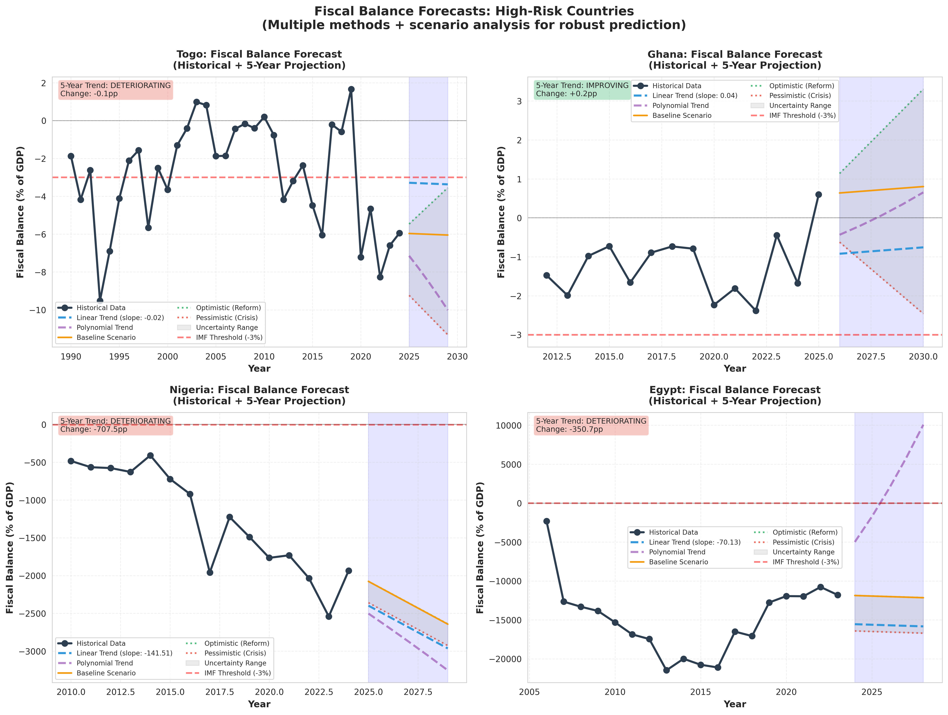
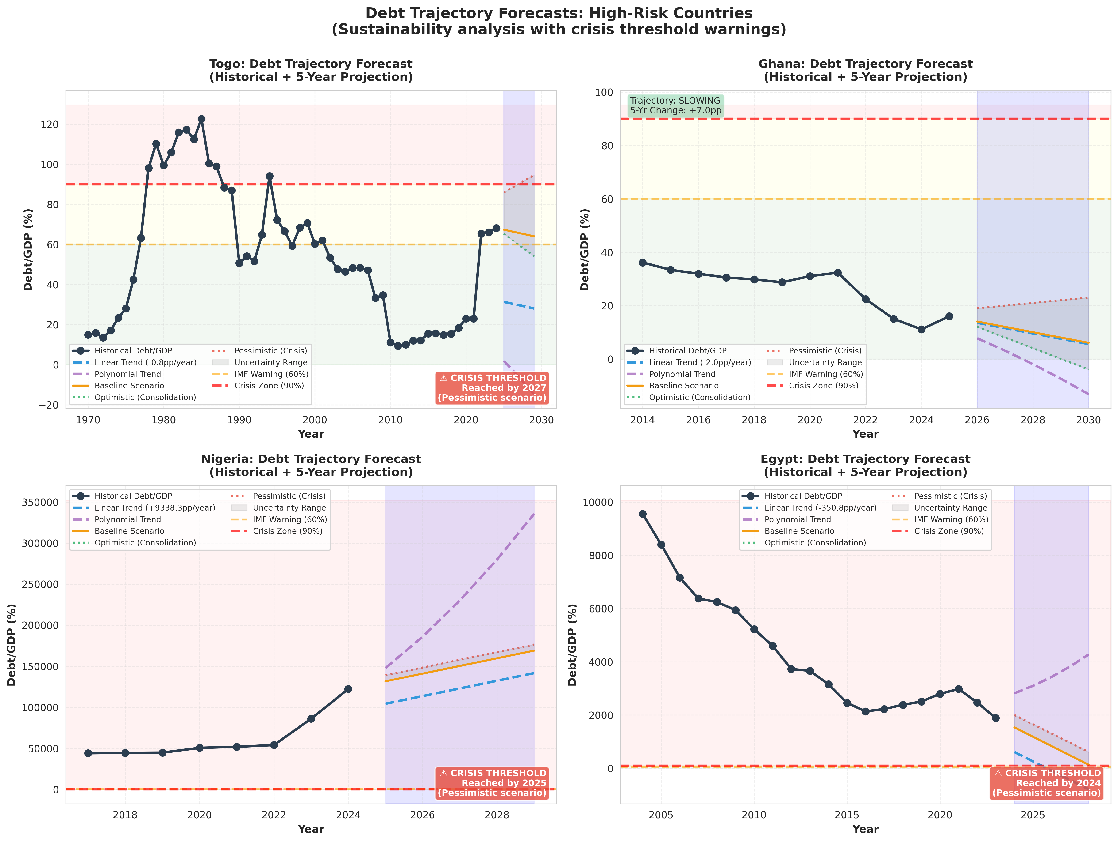
KEY FINDINGS: FORECASTING (2025–2029)
Forecast chart

Slide 13
BASELINE FORECAST — Using my numbers
Average fiscal balance change: –264.53 percentage points
Average debt change: +11,230.83 pp
Countries at risk of crisis by 2029: 3
Countries improving: 1
Countries worsening: 3
Countries crossing 90% debt/GDP by 2029: 2
SCENARIOS
🔴 Optimistic (Reforms): Stabilization and gradual recovery
🔴 Baseline: Fiscal risks remain elevated
🔴 Pessimistic (Global Shock): Severe fiscal distress in multiple countries

Slide 14
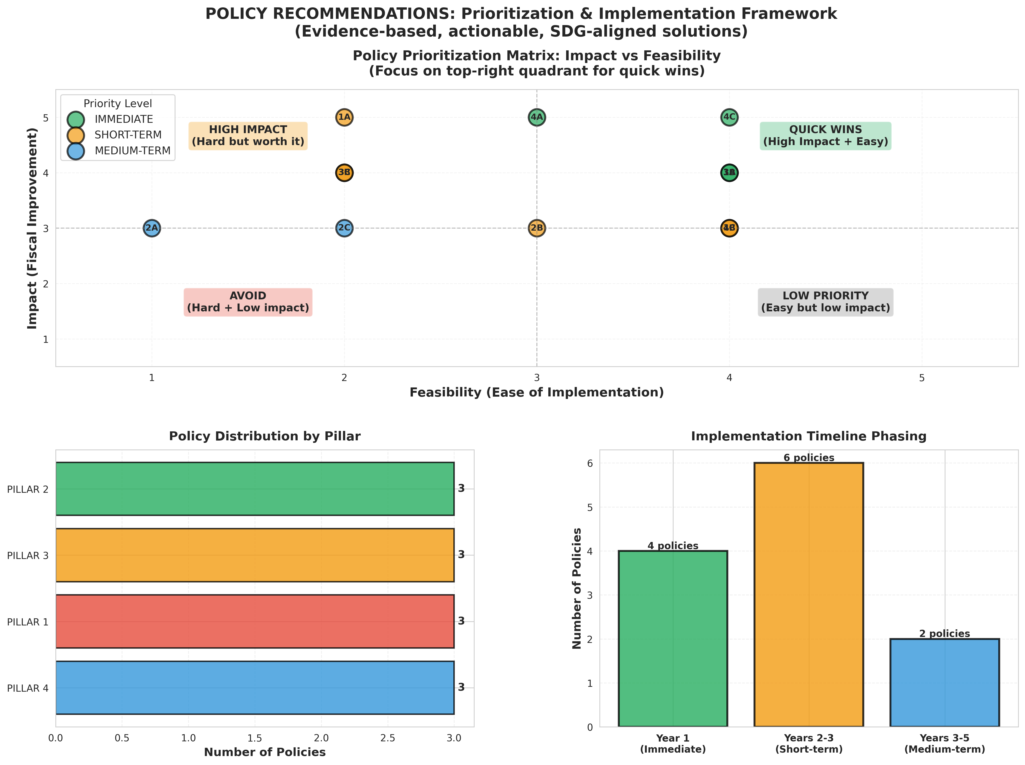
POLICY RECOMMENDATIONS (4-PILLAR FRAMEWORK)
Policy Matrix

Slide 15
THE 4-PILLAR FISCAL RESILIENCE FRAMEWORK
1. Revenue Diversification & Stabilization
Reduce commodity dependence
Build stabilization funds
Expand tax bases
2. Expenditure Efficiency & Flexibility
Strengthen PFM systems
Optimize capital and recurrent spending
3. Institutions & Fiscal Rules
Introduce debt and deficit ceilings
Modernize tax administration
4. Shock Resilience & Regional Cooperation
Contingent financing
Shared African early warning systems

Slide 16
IMPLEMENTATION ROADMAP (5 YEARS)
PHASE 1 — 2025 (Quick Wins)
Create stabilization funds
Deploy real-time fiscal dashboards
Secure emergency financing
PHASE 2 — 2026–2027 (Structural Reforms)
Fiscal responsibility legislation
Tax modernization
Spending efficiency reforms
PHASE 3 — 2028–2029 (Transformation)
Economic diversification
Anti-corruption frameworks
Debt restructuring where required

Slide 17
CONCLUSION & CALL TO ACTION
KEY TAKEAWAYS
Fiscal risks are structural, not temporary
Revenue instability is the root cause
2025–2027 is the critical window for reform
Solutions are proven and actionable
CALL TO ACTION
Policymakers: Begin Phase 1 immediately
Development partners: Support capacity building
Civil society: Promote transparency
Researchers: Strengthen fiscal early-warning systems

Slide 18
THANK YOU ALL THE JUDGES FOR THIS OPPORTUNITY!

